Slide 1
Programming
The Art of talking to Computers

Slide 2
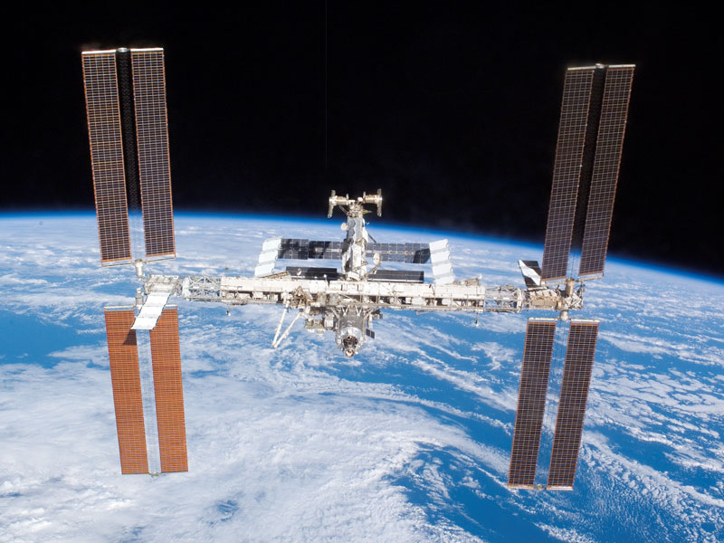
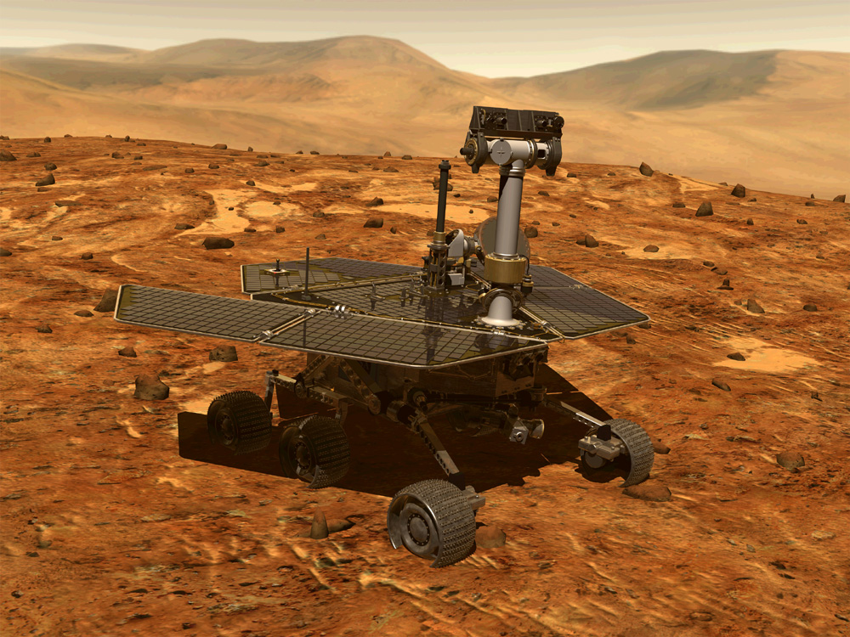


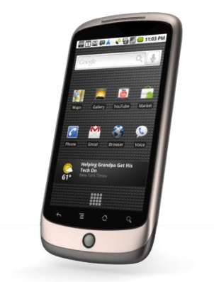
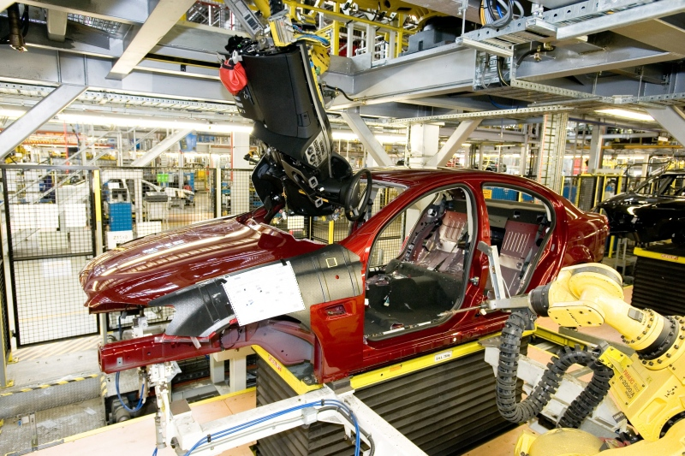

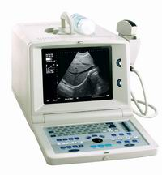


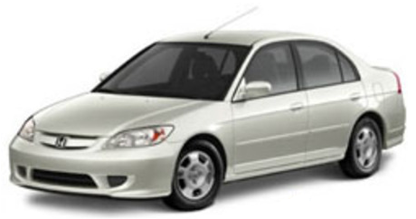

Slide 3
What’s Coding? - Why Care?
Coding:
  The ability to tell the computer what you want it to do.
Coding is important:
  Computer power keeps increasing:
    1990s Computers help with repetitive tasks
    2010s Computers help find solutions
  Computers become more pervasive
    50% of world population have mobile phones (2014)
  Computers influence how we:
    Communicate (Social networks more popular then e-mail)
    Organize: Economically, Socially, Politically
    Consume (Vinyl record – Cassette – CD – MP3 – Stream)
  For Scientists: Quick scripts can save lots of work
  “It now takes me 2min for 500 files instead of 500min for 2 files”

Slide 4












Programming Today (2010s)
Compilers and Interpreters advanced and reliable
Support libraries available for (almost) any purpose
  Communication, Graphics, Numerical Simulations
Support: Forums , Maillists, Live Chat
Business Models:
  Free and Open Source
  Freeware / Shareware
  Commercial
Notes:
Open Source: Anyone can change. People helpful b/c want recognition and pride in product.
Free/Shareware: Profit, Past open source, Service

Slide 5
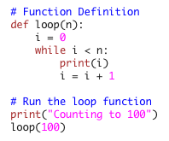
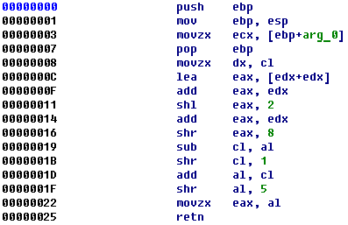
Programming
Program Code vs Machine Language
Computer run machine language (assembler)
Two ways to run a code on a computer:
  Interpreter: Executes program code.
  Compiler: Creates executable file (machine language) from program code

Slide 6

Programming
Today:
Command line (ipython)
Program file
Jupyther
Steep learning Curve
Why Python:
Simple and easy to learn
Mature and wide user base ( help() is available)
Free and open source, platform independent
Libraries for almost anything (hardware, calculations, simulation, visualization, web tools)

Slide 7
Programming Examples
Output:
  print ’Hello User’
  print 3.1415 * 6370
.

Slide 8
Programming Examples
Output:
  print ’Hello User’
  print 3.1415 * 6370
Variables / Formatted output:
  x = 10.5 * 3.3e-1
  name = ’Put your name here’
  print ’My name is‘ + name
  s = ‘X=%.3f Name=%s’ % (x,name)
  print(s, len(s), type(s))
No variable declaration, type is flexible
.

Slide 9
Programming Examples
Output:
  print ’Hello User’
  print 3.1415 * 6370
Variables / Formatted output:
  x = 10.5 * 3.3e-1
  name = ’Put your name here’
  print ’My name is‘ + name
  s = ’X=%.3f Name=%s’ % (x,name)
  print(s, len(s),type(s))
No variable declaration, type is flexible
Conditions / Loops:
  i = 10
  if i > 1:
  print ‘i > 1’
  while i < 10000:
  if i%20 == 0:
  print(i)
  i += 1
4 spaces for each code block!

Slide 10
Programming Examples
Output:
  print ’Hello User’
  print 2 * 3.1415 * 6370
Variables / Formatted output:
  x = 10.5 * 3.3e-1
  name = ’Put your name here’
  print ’My name is‘ + name
  s = ’X=%.3f Name=%s’ % (x,name)
  print(s, len(s),type(s))
  print(5/3, 5/3., 5/float(3))
No variable declaration, type is flexible
Conditions / Loops:
  i = 10
  if i > 1:
  print ‘i > 1’
  while i < 10000:
  if i%20 == 0:
  print(i)
  i += 1
There are ways to break or abort loops
4 spaces for each code block!
Sequences (Lists / Tuples / Strings): have elements
  l = (‘one’, ‘beta’, 3)
  print(l[2])
  print(l)
  # Do a print(l) after each line
  l[1]=2.718
  print l.index(3)
  l.append(‘sth’)
  del l[1]
  l.sort()
  l.insert(0,3e3)
  l = range(10)
  print l[-2]
List[] can change / Tuple() uses less memory
  t = [3, 4]
  t[1] = 0
  print( l + list(t) )
Iterate over the list elements
  for e in l:
  if e%3 < 1:
  print e*e
  print [ e*e for e in l if e%3 < 1 ]
A string is a special kind of list (more on that during jupyter)

Slide 11
More Examples
Modules:
  import math
  print(math.pi,math.sin(x))
  from math import *
  print(exp(x),log10(x),sqrt(x))
len, type, print,repr are built-in functions
(not part of any module)
Help:
  help(math)
  help(x)
  help(len)
  dir() # current namespace names
In ipython only:
  x?
  exp?
If you have time:
  import this
Syntax basics
Python is casESENsitiVe
Spaces are irrelevant except at the start of the line
Comments with # or
‘’’ Multi-Line
Comments
’’’
” and ‘ are interchangeable but need to pair up

Slide 12
Calling Python Programs
Open textstats.py in an editor. Look at the printstats() function
In a terminal navigate to the folder with textstats.py
Run textstats.py by calling
  python textstats.py
Uncomment the different versions of the calls to the printstats function and run the program in each case.
Uncomment the main() in the if condition at the end then run the program by calling
  python textstats.py ”This is Text”
  python textstats.py
  python textstats.py ”This is Text” 3
  Observe how sys.argv and the output change, follow which option the program executes.

Slide 13
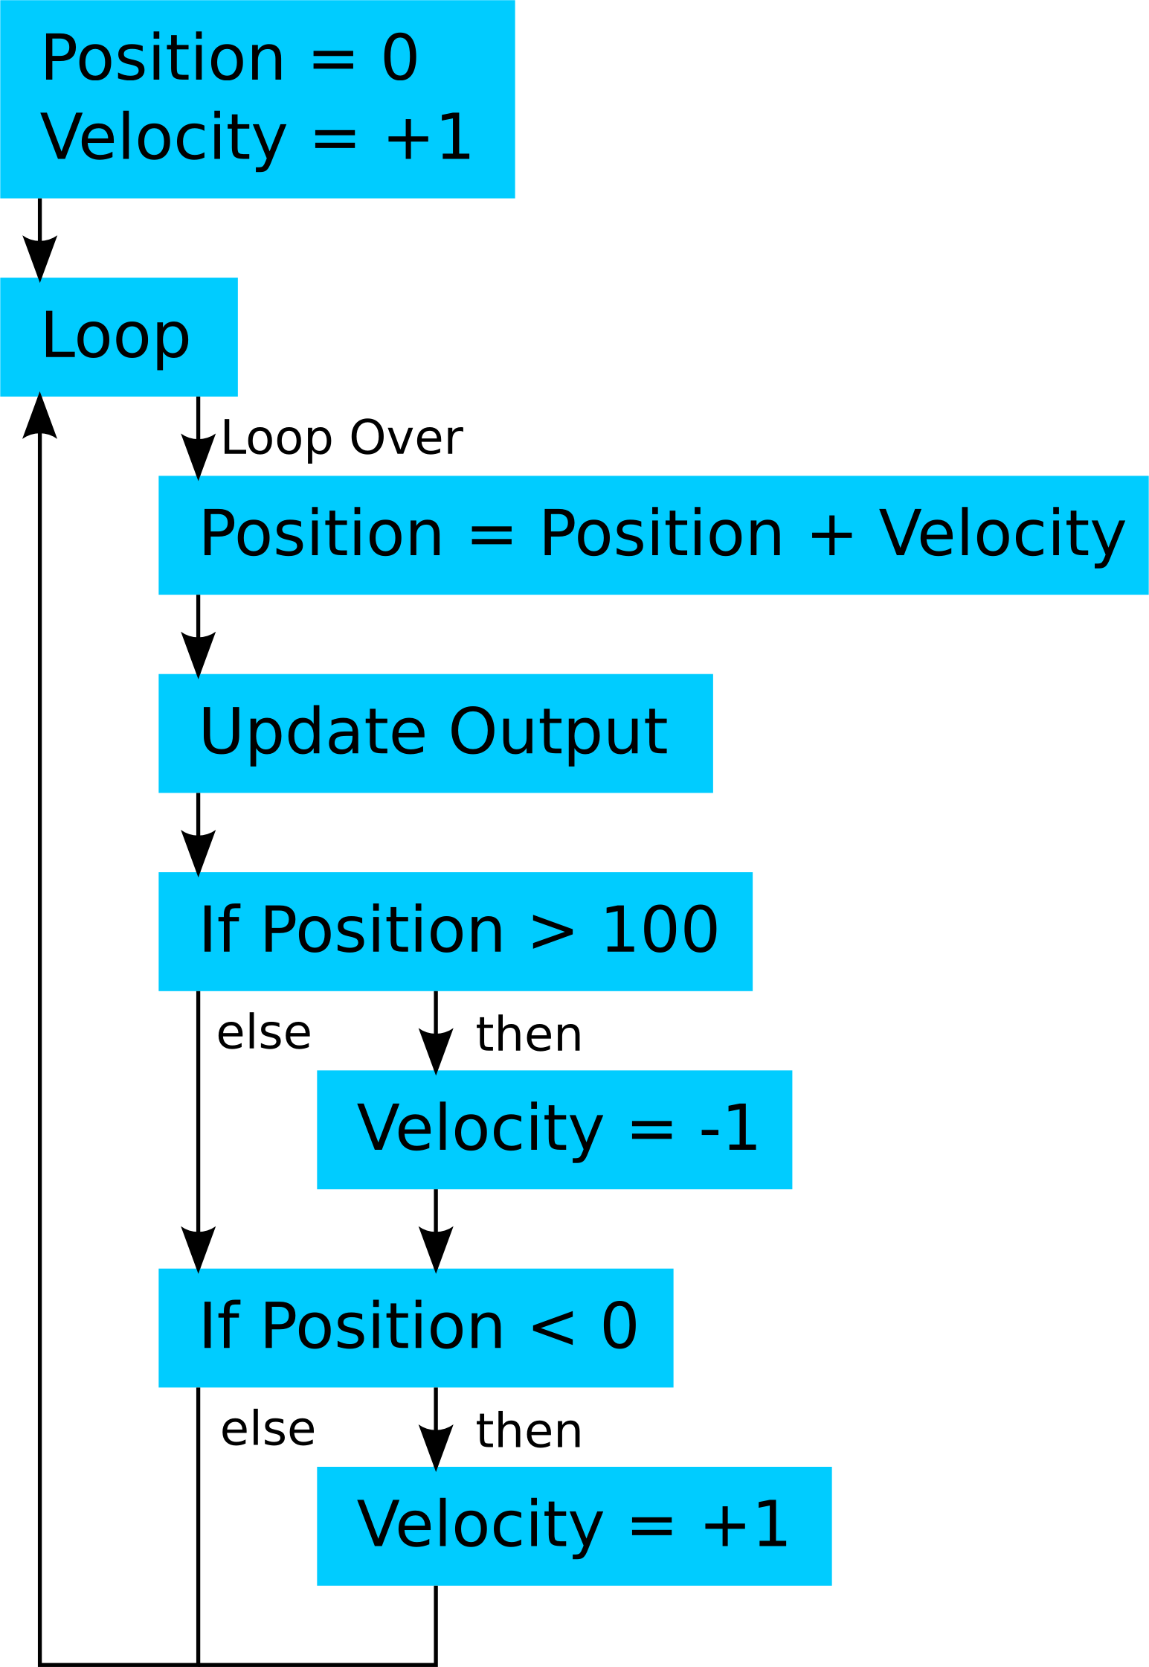
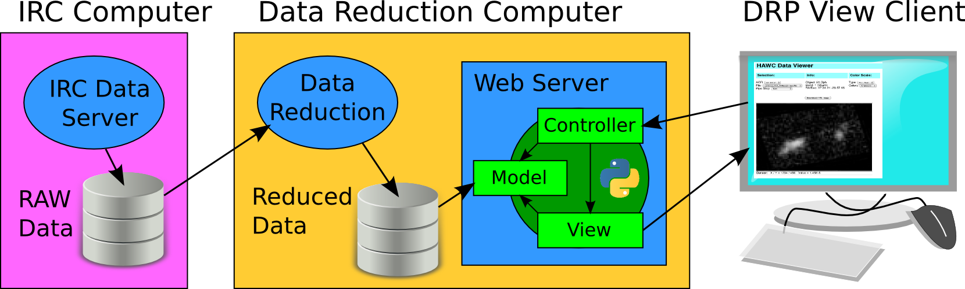
Code Development
Tools:
  Development: Flow, Physical, Case, State Diagrams
  Content management
  Integrated Development Environment (IDE)
Notes:
Give examples for Case, State Diagrams
Show Github page

Slide 14

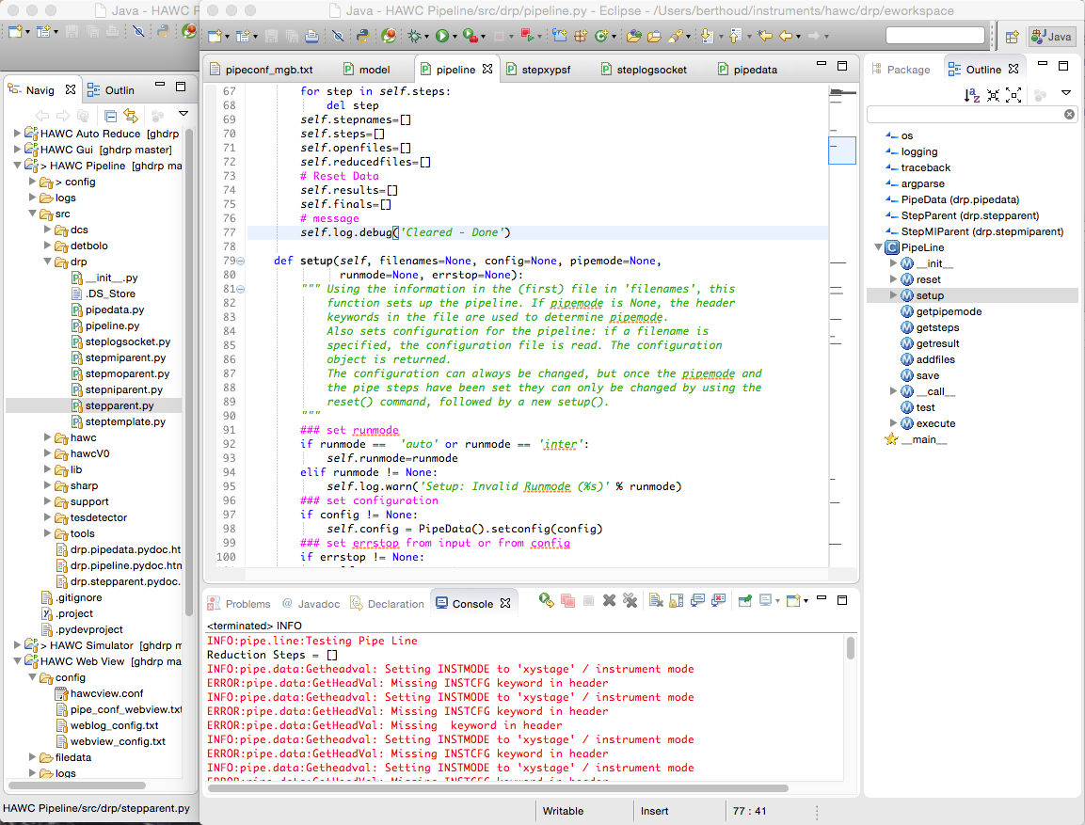
IDE Example:

Slide 15
Best Practices - Programming
DOCUMENT:
  Header: What does this code do, How to use this program, What needs to be connected, Who wrote / modified it, When and What was added/changed
  Inline
    Useful variable names: short, unambiguous, descriptive
    Ex: pinTemp3
    What does the following part of the code do. Describe functions.
    Ex: // Read temperature sensor to tempVal // Store result in file
    Details about individual expressions
    tempVal = ( 5.0 * tempVal / 1023 – 0.5 ) * 100 ; // Convert counts to celsius
  Development process: Why was this implemented in this way – may be published on a wiki / blog
  Why document: Your students will be gone in 2-4 years, you don’t want new students to reinvent the wheel
Notes:
----- Meeting Notes (7/23/16 09:51) -----
Documentation: Add throughts that you have when the code was written. Also log what didn't work.

Slide 16
Best Practices – Programming cont.
Readability:
  Indentation: Keep it consistent (2-4 spaces). Also keep lines < ~80 characters.
  Empty lines: Before each function, between significant blocks for long functions
Modularity: Keep functions short – make separate functions. Keep programs short – make libraries.
  Libraries (or functions) can be reused in other projects
Look for existing code
  Likely someone already wrote something you can use. Copy but give credit.
  Make sure you only copy what you need
Keep older versions – use version control

Slide 17
Best Practices – Programming cont..
Global Parameters:
  Example: Folder and file names, scaling and unit conversion parameters, number of iterations and iteration thresholds, model inputs.
  Method 1: At START of program – easily accessible
  Method 2: Command line parameter with default (and – h)
  Method 3: Configuration file read by program
  Don’t forget: Add parameter value to output file.

Slide 18
Python Documentation
Help
  help(anything) is your friend
  Python and each main package have good (though sometimes extensive) documentation online.
Tutorials / Howto:
  stackexchange.com: User driven Q&A page for almost all your programming / electronics question. Usually tops your google results.
  Python page on the Yerkes Projects page has a good list of links.

Slide 19
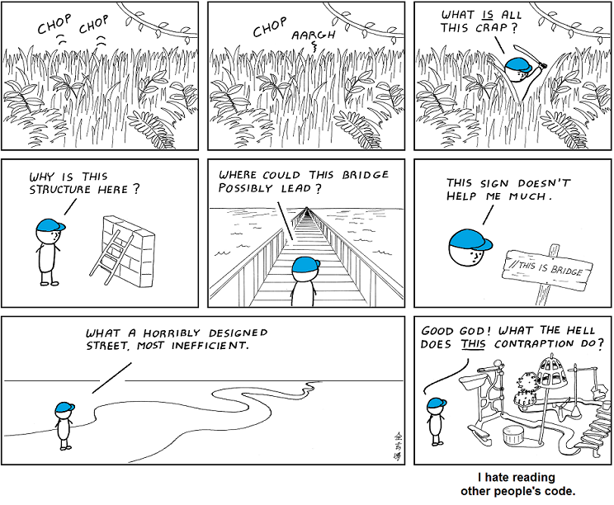
Make Good Code

Slide 20
Data Analysis
Data Storage
  Text File with tab-separated values: Universally readable (excel, python, editor)
    Add column headers (with units if possible)
  Standardize filenames.
    Tip: Include date as (YY)YY-MM-DD in filenames (Month names don’t sort gracefully)
    Avoid spaces in filenames
  Special Formats: FITS (astro images), XL, Binary (efficient but cumbersome)
Analysis tools: How to make nice plots
  Spreadsheet: Open Office, Google Docs, Excel
  Interpreted program: Python, Matlab,
  Online tools: plot.ly or other

Slide 21
Make some Plots
Get Yerkes Telescope Environment data from
stars.uchicago.edu/public/DataLogs
  Format is Date, Time, Floor Height (in), Brightness (Lux), Temperature (C), Humidity (%)
  Link to sensor system at
  stars.uchicago.edu/telescopes/yerkes24/Yerkes24Env.html
  Can you plot yesterday night’s data?
Open your favorite data analysis tool
  Import the data
  Crop the data
  Plot it

Slide 22
Yerkes IT Resources
Stars Server: File Manager, Image Database
Project Page: Yerkes Info and Project Management

Slide 23
Spare Slides Arduino

Slide 24
Arduino Course - Day 1 Plan
Programming and connecting the Arduino Microcontroller
  Arduino overview
  Learn to connect and upload programs to the controller
  Arduino inputs and outputs
  Track 1: C programming introduction
  Track 2: Signal processing, multiple measurements, debugging options
Projects introduction
Lunch
Logger shield and real time clock
Sensors
  Introduction to sensors
  Measuring light, pressure, temperature, humidity, button trigger
  Play with sensors
Projects definition development
Dinner
Observing

Slide 25
Arduino Course – Day 2
Project Development
  Development tools
  Best practices
  Online help
Data Analysis with Excel and iPython
Project Work
Lunch – George Williams
Yerkes Tour
Project Work – Yerkes Library and FabLab
Project Presentations – Yerkes Library

Slide 26
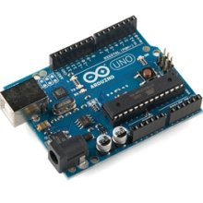
Arduino Microcontroller
Single – board microcontroller
CPU: 16MHz 32KB Flash, 1KB EEPROM
USB / Serial computer connection
Multiple analog and digital inputs and outputs
On-board power regulator
C-based programming language.
Notes:
Wide use: Help and examples available (more tomorrow)

Slide 27
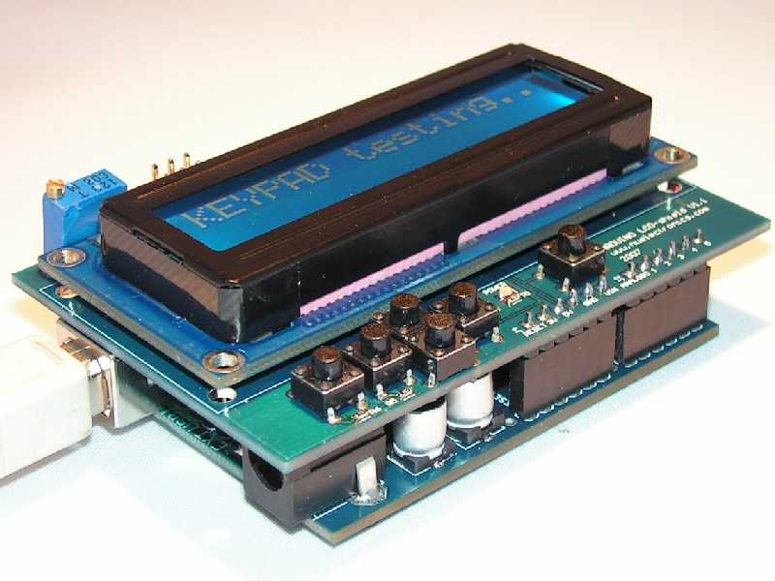
Why Use Arduino
Arduinos are Cheap - $25-30
Powerful but easy to learn. Rugged design tolerates errors.
Open source design and software
  Large selection of compatible boards and shields
  Many free libraries and add-on programs
Wide user base of scientists, engineers, hobbyists and educators
  Help is available online
  Examples are published to connect almost any piece of hardware to an Arduino
  Numerous sample projects for free downloading
Notes:
SHOW: compatible board, other board formats, shields

Slide 28
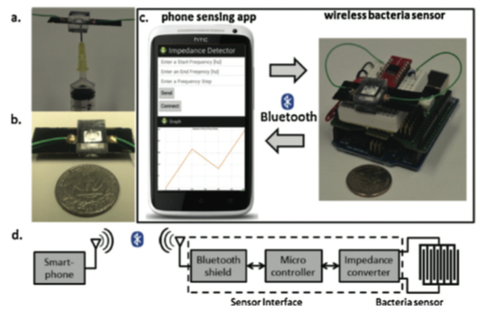
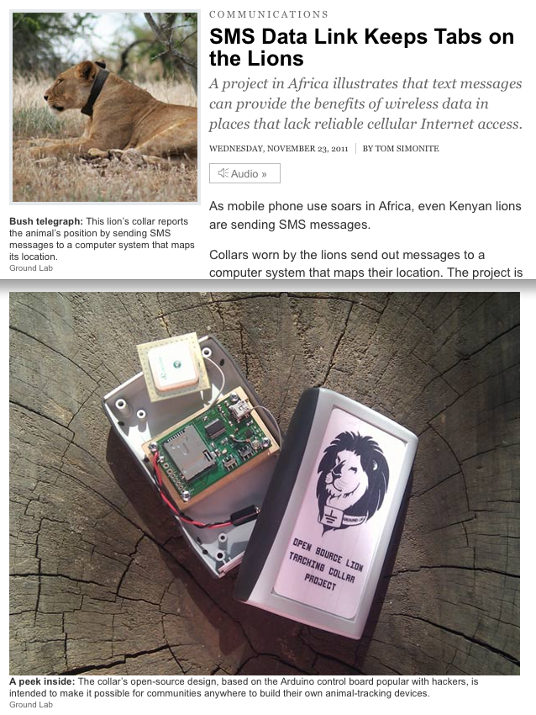
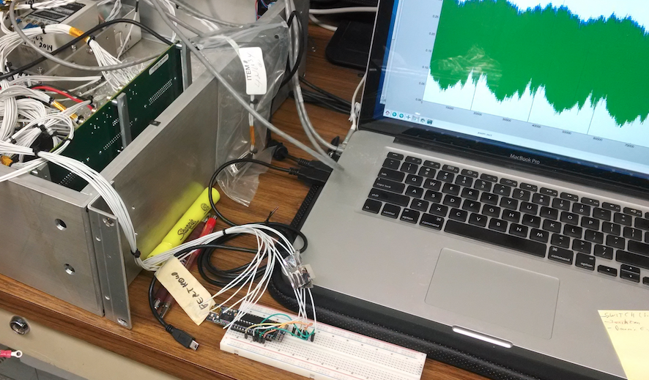
Arduino Examples

Slide 29
Let’s Arduino
Connect the Arduino to your computer with the USB cable.
Start the Arduino program
Run the Blink example program
  Go to File → Examples → 01. Basics → Blink
  Upload the program to the Arduino. Check settings under Tools → Board and Tools → Port.
  Option: Connect an LED with 220Ω resistor to pin 13.
  Challenge: Change blink frequency
  Challenge: Make advanced blink pattern
Run the AnalogReadSerial example program
  Go to File → Examples → 01. Basics → AnalogReadSerial
  Upload the program to the Arduino.
  Open the Serial Monitor (under Tools), get voltages from GND, 3.3V, 5V
  Option: Connect a variable resistor to GND and 5V to generate any input
Notes:
Talk about Arduino Program

Slide 30
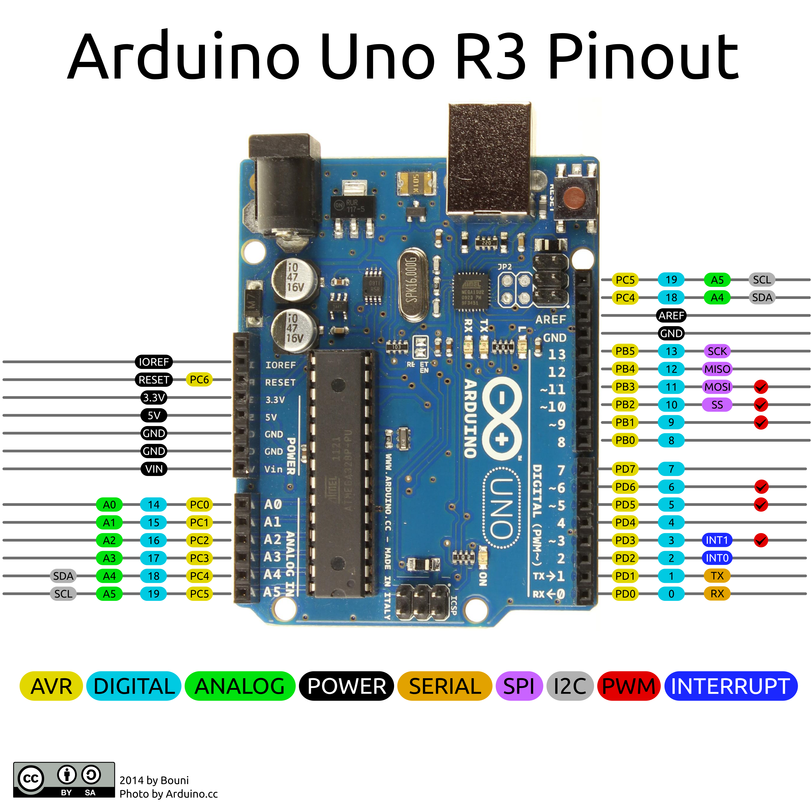
Connections
Digital Pins 0-19: Can be OUTPUT / INPUT / INPUT_PULLUP
Analog Input: Read 0-5V with 0-1023 resolution.
Analog Output (PWM at 500Hz): Generate square wave signal with appropriate duty cycle
Serial: Pins 0, 1 for serial communication (also USB)
  Other pins can be used by software
Power: GND, 3.3V, 5V, VIN (i.e. the power on the barrel plug) and Reset
SPI and I2C: Pins for serial communication (other pins can be used)

Slide 31
Code Examples
In the Arduino Program under File→Examples
  01 Basics → Fade: Uses analog output to fade light
  01 Basics → ReadAnalogVoltage: Contains voltage conversion.
  02 Digital → toneMelody: Uses array to store a melody
  03 Analog → Smoothing: Stores values in array for averaged output
  03 Analog → Fading: Fading with for loop.
Yerkes examples: Download them at
stars.uchicago.edu/public/BuildYourOwn/Arduino/Printouts
  Dark count: Counts number of seconds darkness is detected
  RGB_LED: Cycles through colors with RGB LED. Includes function declaration.

Slide 32
Coding Topics
Statistics (avg, stdev ( ) , median)
lowpass filter now = f * old + (1-f) * new
States: counters / instrument mode
Vectors and Matrices: int array[2] = {0, 1}
Functions: int square(int x) { return x*x; }
Eeprom: permanent data storage
Timing: delay, millis
Objects for utilities: display, temp sensor
Notes:
I

Slide 33
Best Practices – Electronics
Lab Practices:
Wear safety glasses
Don’t rewire powered devices
  Check connections before powering up
If in doubt consult manuals / reference material
Deployment:
Test EVERYTHING at least twice before actual deployment.
  Includes: final program, electronics, power source, housing
  Many bugs only show up in fully integrated systems
Documentation: Use fritzing for making schematics, breadboard and PCB layouts: fritzing.org/home
Notes:
Demonstrate Fritzing
----- Meeting Notes (7/23/16 10:07) -----
Companies makes boards for ~$5. Eagle is also good

Slide 34
Arduino Documentation
Arduino:
  www.arduino.cc: main Arduino page, contains tutorials, reference material and information on connecting additional tools.
Tutorials / Howto:
  stackexchange.com: User driven Q&A page for almost all your programming / electronics question. Usually tops your google results.
  www.instructables.com: includes tutorials for using arduino.
  hackaday.com: Many DIY ideas, several including arduino.
  edwardmallon.wordpress.com: Blog on building Arduino-based loggers for environmental monitoring. Many good links.
Suppliers: Most sell Arduinos and other compatible electronics.
  adafruit.com: Also has good tutorials / learning site.
  sparkfun.com: Has many interesting parts – also more mundane ones

Slide 35
Embedded Electronics

Slide 36
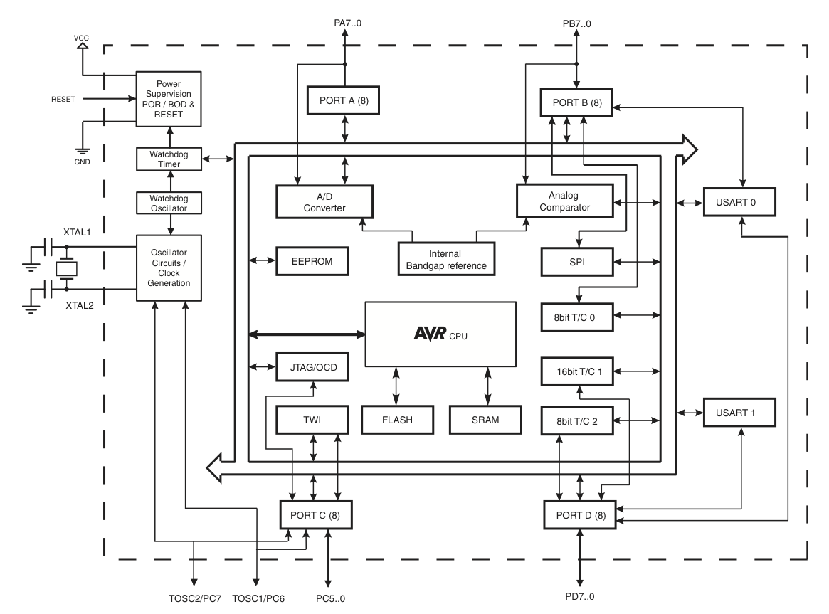
Arduino Architecture

Slide 37
Spare Slides Computing / Coding

Slide 38

Computers are – fast
Requirement: Quick reaction to sensor input
Many implementations: safety systems, transportation
Current research:
  Large data inputs (image stabilization)
  Complex control applications (driving, data load balance)
Notes:
Safety Sys: Security, Fire Alarm, Trans: elevator

Slide 39
Computer work – A LOT
Requirement: large data transfer and analysis
Available Solutions:
  Network hard- & software
  multi-core CPUs
  quick (de)compression of streamed data
  data loss optimization
Research:
  Cheap compression and encryption

Slide 40
Computers become - intelligent
Requirement: Expert analysis of large data sets ➔ fuzzy answer
Solutions:
  Google deep learning algorithm
  Large-scale weather simulations
Research:
  Speed optimization
  Increased intelligence
  Common sense solutions
  Real-time interaction

Slide 41
What can we do?
Computational Thinking =
Critical Thinking + Machine Intelligence
Knowing how to code:
  Tell the computer what to do
  Determine what others do on their computers

Slide 42

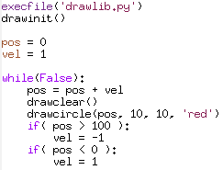
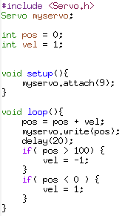
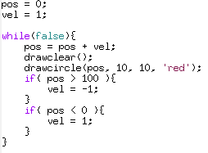
Languages
Python Arduino Javascrip (HTML)

Slide 43

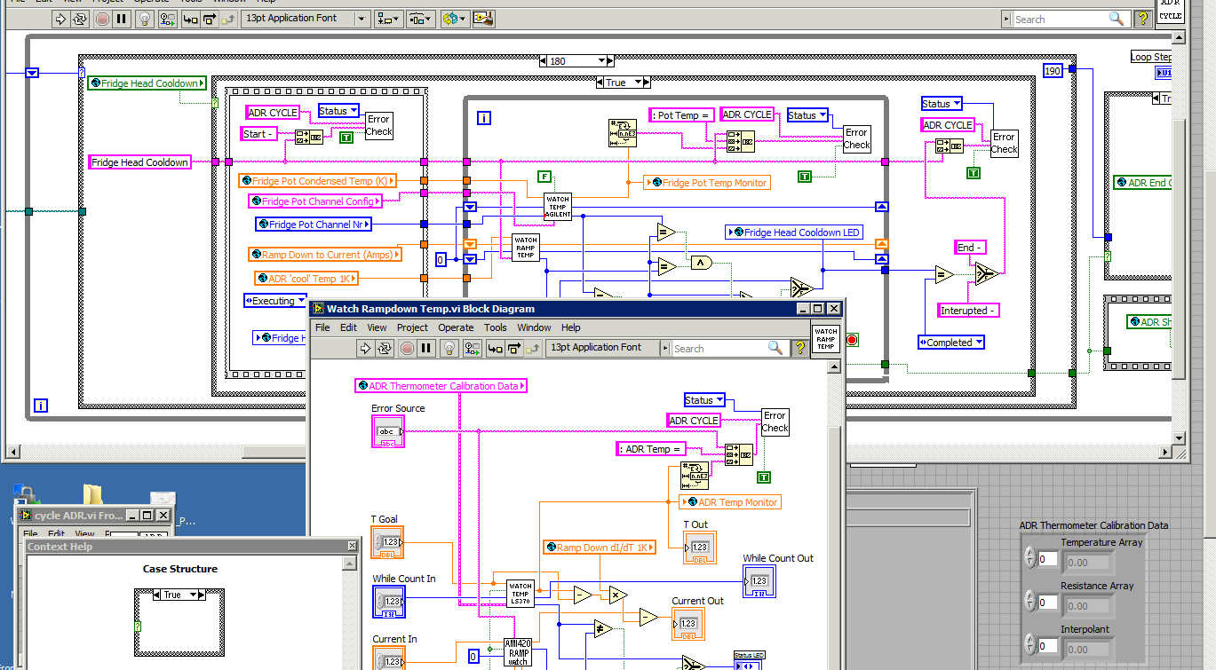
LabView

Slide 44
What is a Program ?
Computers are STUPID, FAST and PRECISE
A program is a list of
Detailed Instructions
Example Program:
repeat:
read the temperature
if it’s below 10C:
switch on the heater
if it’s above 20C
switch off the heater
go back
By programming you can teach a computer to do
ANYTHING
(almost)

Slide 45
Spare Slides Data Acq / Sensors

Slide 46
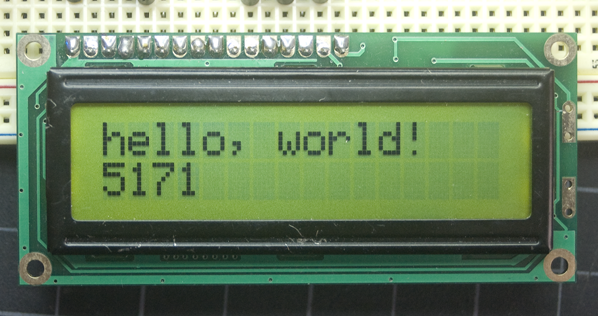
Data Logger Shield
Contains a real time clock (RTC) and SD card reader.
Run through the adafruit tutorial at
learn.adafruit.com/adafruit-data-logger-shield
Run through the sections
  Overview
  Shield overview
  Downloads – to install the SC and RTC libraries on your computer.
  Using the Real Time Clock
  Using the SD Card
Other useful tool: LCD display
Allows display of values and
results at runtime.
Uses quite a few pins
Takes time to code

Slide 47
Sensors
Basic Types
  Analog: Measure resistance, voltage or time interval. Simpler to use but may need calibration and noise handling
  Digital: Communicate with Arduino using digital protocols (1-Wire, I2C or SPI). Have built-in microcontroller that communicates with external electronics (i.e. Arduino).
Calibration: May be required by all sensors for adequate results.
  Example: Temperature sensor offset adjustment with ice water

Slide 48
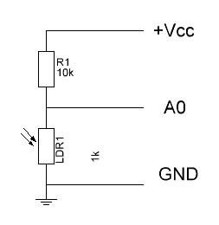

Analog Sensors
Resistor Sensor
  Measure with voltage divider
  Reference resistor determines range, see XL
  Requires calculation to get measured value.
  Examples: Gas sensors, luminosity
Voltage Sensor
  Generates voltage related to measured value
  Examples: 3-axis accelerometer, TMP36
T(C) = 100^{C}/_{V} (V_{in} – 0.5V)
Notes:
XL: Describe math, plot, basic, idea, issues and consequences

Slide 49
Available Sensors
Sensors in your Package: Follow the link below for description of all your sensors.
www.sunfounder.com/37-modules-sensor-kit-v2-0-for-arduino-1130.html
  CdS photoresistor: Resistive light sensor
  RHT03 Temperature & Humidity Sensor: Digital readout, 1-Wire protocol.
  BMP180 Barometric Pressure / Temperature / Altitude Sensor: Digital I2C protocol
Other sensors for experiments:
  TMP36 Temperature Sensor: Voltage output proportional to temperature.
  DS18B20 Waterproof Temp Sensor: Digital readout, 1-Wire
  LV EZ3 Ultrasonic Range Finder: Returns pulse duration, use pulseIn() function.
  Gas sensors: Alcohol MQ-3, Methane MQ-4, CO MQ-7, Hydrogen MQ-8. Measure resistance with given voltage.
  MMA7361 Triple Axis accelerometer: Analog voltage readout for each axis.
  Motion Detector
  Radio sender / receiver 434MHz: Simple sender and receiver
  RFM69 Radio Transceiver 433MHz: Intelligent sender/receiver microcontroller.
Interface:
  Dynagraph.py

Slide 50
Let’s do Sensors
For each sensor in your package, run the basic tutorial program online.
  You might have to install additional libraries, see www.arduino.cc/en/Guide/Libraries
  for details.
Select and test one of the other sensors.

Slide 51
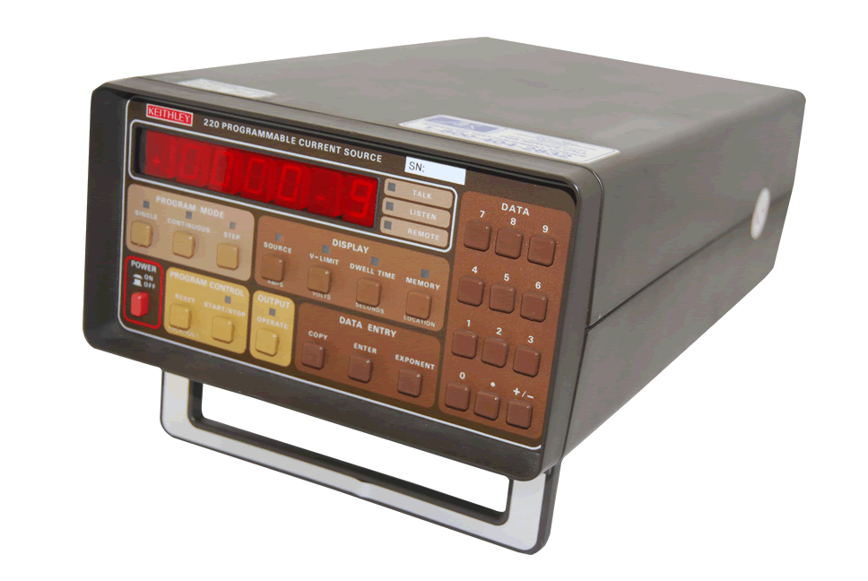
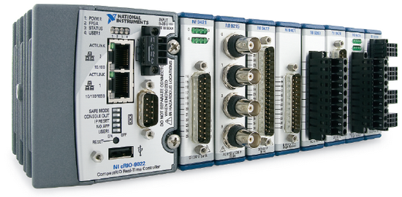
Microcomputer Systems
Most instruments have embedded microcomputers.

Slide 52
